Slide 1
8085 instruction execution and datapath
JIIT-128, Noida

Slide 2
Microprocessor –Initiated Operations and 8085 Bus Organization
The MPU perform four primary operations:
Memory Read: Read data (or instruction) from memory
Memory Write: Read data (or instruction) from memory
I/O Read: Accept data from Input devices
I/O write: Sends data to output devices
JIIT-128, Noida

Slide 3
Microprocessor –Initiated Operations and 8085 Bus Organization
To communicate with a peripheral (or a memory location), the MPU needs to perform the following steps:
Step 1: Identify the peripheral or the memory location(with its address)
Step2: Transfer binary information(data and instructions)
Step 3: Provide timing and synchronization signals.
JIIT-128, Noida

Slide 4
Program 8085 Bus Organization
The 8085 MPU perform these functions using three set of communication lines called Buses:
The address bus
The data bus
The control bus
These buses are shown as one group, called the system bus
JIIT-128, Noida

Slide 5
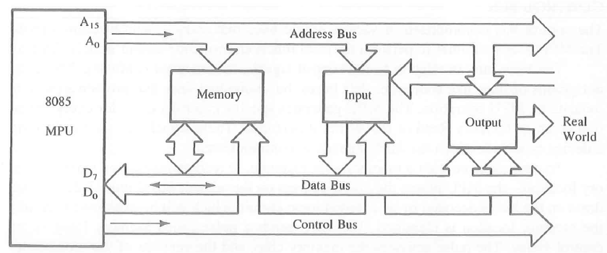
8085 Bus Organization
Figure 1 [1] 8085 Bus Organization
JIIT-128, Noida

Slide 6
Address Bus
The address bus is a group of 16 lines generally identified as A0 to A15.
One wire for each bit, therefore 16 bits = 16 wires
The address bus is unidirectional. ie numbers only sent from microprocessor to memory, not other way
The MPU uses the address bus to perform the first function: identifying a peripheral or a memory location
A 16 bit binary number allows 2^16 different numbers, or 32000 different numbers, ie 0000000000000000 up to 1111111111111111.
JIIT-128, Noida

Slide 7
Address Bus
memory consists of boxes,each with a unique address, the size of the address bus determines the size of memory,which can be used.
To communicate with memory the microprocessor sends an address on the address bus, eg 0000000000000011 (3 in decimal), to the memory.
The memory the selects box number 3 for reading or writing data.
Most 8-bit microprecessors have 16 address lines
JIIT-128, Noida

Slide 8
Data Bus
Data Bus: carries ‘data’, in binary form, between μP and other external units, such as memory.
Typical size is 8 or 16 bits, Bus is bi-directional
The Data Bus typically consists of 8 wires. Therefore, 28 combinations of binary digits
Data bus used to transmit "data", ie information, results of arithmetic, etc, between memory and the microprocessor.
JIIT-128, Noida

Slide 9
Data Bus
Size of the data bus determines what arithmetic can be done.
If only 8 bits wide then largest number is 11111111 (255 in decimal)
Therefore, larger number have to be broken down into chunks of 255. This slows microprocessor.
Data Bus also carries instructions from memory to the microprocessor.
Size of the bus therefore limits the number of possible instructions to 256, each specified by a separate number.
JIIT-128, Noida

Slide 10
Control Bus
Control Bus are various lines which have specific functions for coordinating and controlling uP operations
Eg: Read/NotWrite line, single binary digit.
Control whether memory is being ‘written to’ (data stored in mem) or ‘read from’ (data taken out of mem) 1 = Read, 0 = Write.
May also include clock line(s) for timing/synchronising, ‘interrupts’, ‘reset’ etc.
Typically μP has 10 control lines. Cannot function correctly without these vital control signals.
JIIT-128, Noida

Slide 11
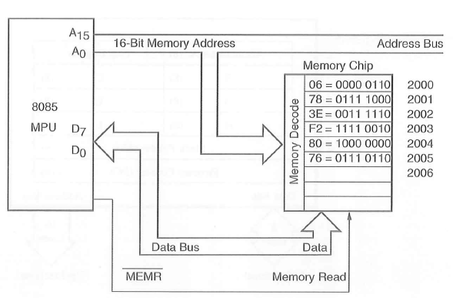
Memory read operation
Figure 2 [1] Memory read operation
JIIT-128, Noida

Slide 12
Internal Data Operations and the 8085 Registers
Store 8 bit data
Perform arithmetic and logical operations
Test for conditions
Sequence the execution of Instructions
Store data temporarily during execution in the defined R/W memory locations called the stack.
JIIT-128, Noida

Slide 13
References
Gaonkar, R. S. (1990). Microprocessor Architecture, Programming and Applications with the 8085. Fifth Edition Prentice Hall PTR.

